Slide 1
Unbiased Estimation of the Gini Index
Banu Badil
Victor de la Pena
Haolin Zou
Notes:
封面标题特殊字体为百度简综艺。可以自行下载使用或改为微软雅黑。
1

Slide 2
1
2
3
PART ONE
PART TWO
PART THREE
Two Gini Indices
Unbiasedness
A Related Result

Slide 3


Two Gini Indices
The Gini index was developed by Corrado Gini as a measure of dispersion intended to represent the income inequality within a nation or a social group. A Gini coefficient of zero happens when all values are the same (where everyone has the same income). A Gini coefficient close or equal to one signifies maximal inequality, where only one person has all the income. When using a continuous distribution to characterize individual income, the Gini coefficient can be expressed as
$$G=\frac{1}{2μ}∫∫f\left(x\right)f\left(y\right)\left|x−y\right|dxdy \\ =\frac{1}{2μ}E|X−Y|$$
where $f(⋅)$ is the density function, $μ$ is the mean of the distribution, and X, Y are iid with density $f⋅)$
Gini index, or Gini impurity in machine learning, on the other hand, characterizes classification dispersion:
$$I_{G}\left(p\right)=1−\sum_{j=1}^{J}{p_{j}^{2}}$$
Where $p_{j}$ is the proportion of jth category in the population. It is minimal when there is only one category ($p_{1}=1)$ and maximal when $p_{j}=\frac{1}{J}$ are equal.
WE SHOULD NOT MIX THEM!

Slide 4
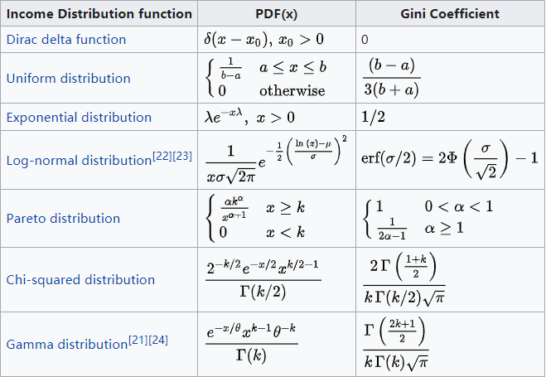
Gini coefficient for some continuous distributions

Slide 5



Unbiasedness for Gamma distribution
Our main result is as follows. Suppose the population follows a Gamma(a, b) distribution with density
$$f\left(x\right)=\frac{b^{−a}}{Γ(a)}x^{a−1}e^{−\frac{x}{b}} , x>0$$
We know the corresponding Gini coefficient is
$$G(a)=\frac{Γ(a+\frac{1}{2})}{aΓ\left(a\right)\sqrt{π}}$$
Let $Y_{1}, ⋯, Y_{n}$ be iid Gamma(a, b) random variables. Define the sample Gini coefficient as:
$$\hat{G}=\frac{\frac{\sum_{1≤i≠j≤n}{|Y_{i}−Y_{j}|}}{n(n−1)}}{2\overline{Y}}$$
Where $\overline{Y}$ is the sample mean. It is the natural ‘empirical’ version of Gini coefficient in the last page.
The main result in our paper is:
$$E\hat{G}=G$$

Slide 6




Proof (sketch)
Proof:
First notice that $\int_{0}^{∞}{e^{−zs}dz}=\frac{1}{s}$ . Replacing s by $∑Y_{i}$ we have
$$E\left[\frac{\sum_{1≤i≠j≤n}{\left|Y_{i}−Y_{j}\right|}}{∑Y_{i}}\right]=E\left[\left(\sum_{1≤i≠j≤n}{\left|Y_{i}−Y_{j}\right|}\right)\int_{0}^{∞}{e^{−z\left(∑Y_{i}\right)}dz}\right] \\ =n\left(n−1\right)E\left[\left|Y_{1}−Y_{2}\right|\int_{0}^{∞}{e^{−z\left(∑Y_{i}\right)}dz}\right] \\ =n\left(n−1\right)E\left[\left|Y_{1}−Y_{2}\right|\int_{0}^{∞}{e^{−z\left(Y_{1}+Y_{2}\right)}E\left[e^{−z\left(Y_{3}+…+Y_{n}\right)}\right]dz}\right] \\ =n\left(n−1\right)E\left[\left|Y_{1}−Y_{2}\right|\int_{0}^{∞}{e^{−z\left(Y_{1}+Y_{2}\right)}{\left(\frac{1}{bz+1}\right)}^{a\left(n−2\right)}dz}\right] \\ =2n\left(n−1\right)E\left[\left(Y_{1}−Y_{2}\right)1_{\left\{Y_{1}>Y_{2}\right\}}\int_{0}^{∞}{…dz}\right] \\ =2n\left(n−1\right)\left[E\left[Y_{1}1_{\left\{Y_{1}>Y_{2}\right\}}\int_{0}^{∞}{…dz}\right]−E\left[Y_{2}1_{\left\{Y_{1}>Y_{2}\right\}}\int_{0}^{∞}{…dz}\right]\right]$$
by first conditioning on $Y_{1}, Y_{2}$ and taking expectation inside the integral (Fubini).
$E\left[e^{−z\left(Y_{3}+…+Y_{n}\right)}\right]$= ${\left(\frac{1}{bz+1}\right)}^{a\left(n−2\right)}$ is the Laplace transform of $Y_{3}+…+Y_{n}$ which is Gamma(a(n-2), b) distribution.
by symmetry of $Y_{1}, Y_{2}$

Slide 7



Proof (sketch)
Proof (continued):
By straight integration we have the following results:
$$E\left[Y_{1}1_{\left\{Y_{1}>Y_{2}\right\}}\int_{0}^{∞}{…dz}=\frac{1}{an}\frac{Γ\left(2a+1\right)}{{\left(Γ\left(a\right)\right)}^{2}}\int_{0}^{\frac{π}{4}}{\frac{{\left(cosθ\right)}^{a}{\left(sinθ\right)}^{a−1}}{{\left(cosθ+sinθ\right)}^{2a+1}}}dθ\right]$$
And similarly
$$E\left[Y_{2}1_{\left\{Y_{1}>Y_{2}\right\}}\int_{0}^{∞}{…dz}=\frac{1}{an}\frac{Γ\left(2a+1\right)}{{\left(Γ\left(a\right)\right)}^{2}}\int_{0}^{\frac{π}{4}}{\frac{{\left(cosθ\right)}^{a−1}{\left(sinθ\right)}^{a}}{{\left(cosθ+sinθ\right)}^{2a+1}}}dθ\right]$$
Subtracting them and the integrand becomes
$$\frac{{\left(cosθ\right)}^{a}{\left(sinθ\right)}^{a−1}−{\left(cosθ\right)}^{a−1}{\left(sinθ\right)}^{a}}{{\left(cosθ+sinθ\right)}^{2a+1}} \\ =\frac{{\left(cosθsinθ\right)}^{a−1}(cosθ−sinθ)}{{\left(cosθ+sinθ\right)}^{2a+1}} \\ =\frac{2^{−a+1}{\left(sin2θ\right)}^{a−1}cos2θ}{{\left(1+sin2θ\right)}^{a+1}}$$
Letting $u=sin2θ$ and integrating on$\left[0,\frac{π}{4}\right]$ yields
$$\int_{0}^{\frac{π}{4}}{…dθ}=2^{−a+1}\int_{0}^{1}{\frac{u^{a−1}}{{2\left(1+u\right)}^{a+1}}}du=…=\frac{1}{a}{\left(\frac{1}{2}\right)}^{2a}$$
by symmetry of $Y_{1}, Y_{2}$
$$\frac{u^{a−1}}{{2\left(1+u\right)}^{a+1}}du=−d\left(\frac{1}{2a} {\left(\frac{u}{1+u}\right)}^{a}\right)$$

Slide 8


Proof (sketch)
Proof (continued):
Finally we insert it back and have
$$E\hat{G}=\frac{1}{2(n−1)}E\left[\frac{\sum_{1≤i≠j≤n}{\left|Y_{i}−Y_{j}\right|}}{∑Y_{i}}\right] \\ =\frac{1}{2\left(n−1\right)}2n\left(n−1\right)\frac{1}{an}\frac{Γ\left(2a+1\right)}{{\left(Γ\left(a\right)\right)}^{2}}\frac{1}{a}{\left(\frac{1}{2}\right)}^{2a} \\ =\frac{1}{a^{2}}{\left(\frac{1}{2}\right)}^{a+1}\frac{Γ\left(2a+1\right)}{{\left(Γ\left(a\right)\right)}^{2}} \\ =\frac{Γ(a+\frac{1}{2})}{aΓ\left(a\right)\sqrt{π}} \\ =G$$
$$Γ\left(2a+1\right)=2aΓ\left(2a\right) \\ =2a∗\frac{2^{2a−1}}{\sqrt{π}}Γ\left(a\right)Γ\left(a+\frac{1}{2}\right)$$

Slide 9
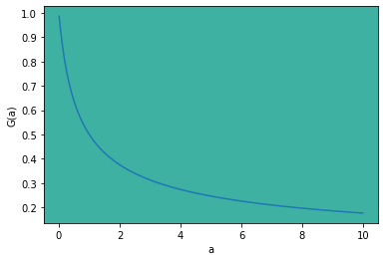

A relationship with previous work
In Warrens(2018) they proved that $\hat{G}$ has a ‘downward bias’ when we regroup the original dataset by equal sized subgroups, for example, when we are interested in income per capita but only family-level data is available
Indeed, if we regroup $\{Y_{1}, …, Y_{n}\}$ by
$$\{Y_{1}+…+Y_{d}, Y_{d+1}+…+Y_{2d}, … , Y_{n−d+1}+…+Y_{n}\}$$
It becomes a new dataset from Gamma(d*a, b) with size n/d.
Adirect corollary from our theorem is that the new sample Gini coefficient, denoted by $\hat{G}′$, has the following expectation
$$E{\hat{G}}^{′}=G\left(da\right)=\frac{Γ(da+\frac{1}{2})}{daΓ\left(da\right)\sqrt{π}}$$
We know $G(a)$ is a decreasing function, as shown in the right. Therefore we can measure the downward bias exactly in its expectation:
$$E\left(bias\right)=E\left({\hat{G}}^{′}−\hat{G}\right)=G\left(da\right)−G(a)$$

Slide 10
THANK YOU

